Slide 1


Slide 2
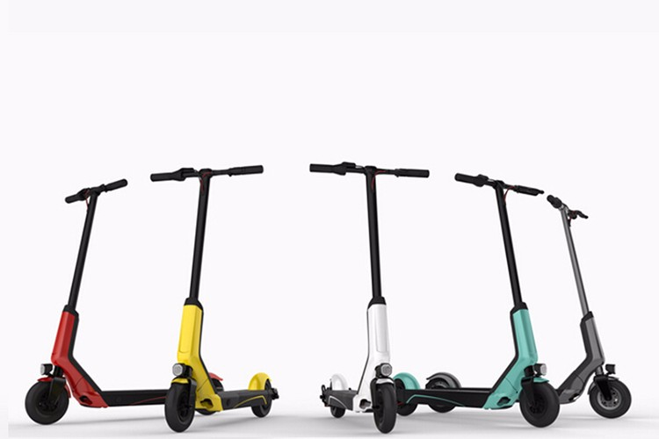
Introducing Google Go
A new and safer scooter experience powered by Google.
Notes:
Hi, We’re Team 5 & we’re introducing the Google Go- a new ans safer scooter experience, powered by Google.

Slide 3
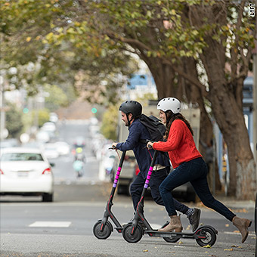
Google Go focuses on features that protect the riders
Problem:
-Increasing # of e-scooter related accidents
-Lack of rider safety features on scooters
Objective:
-Design an electric scooter with advanced safety features

Slide 4
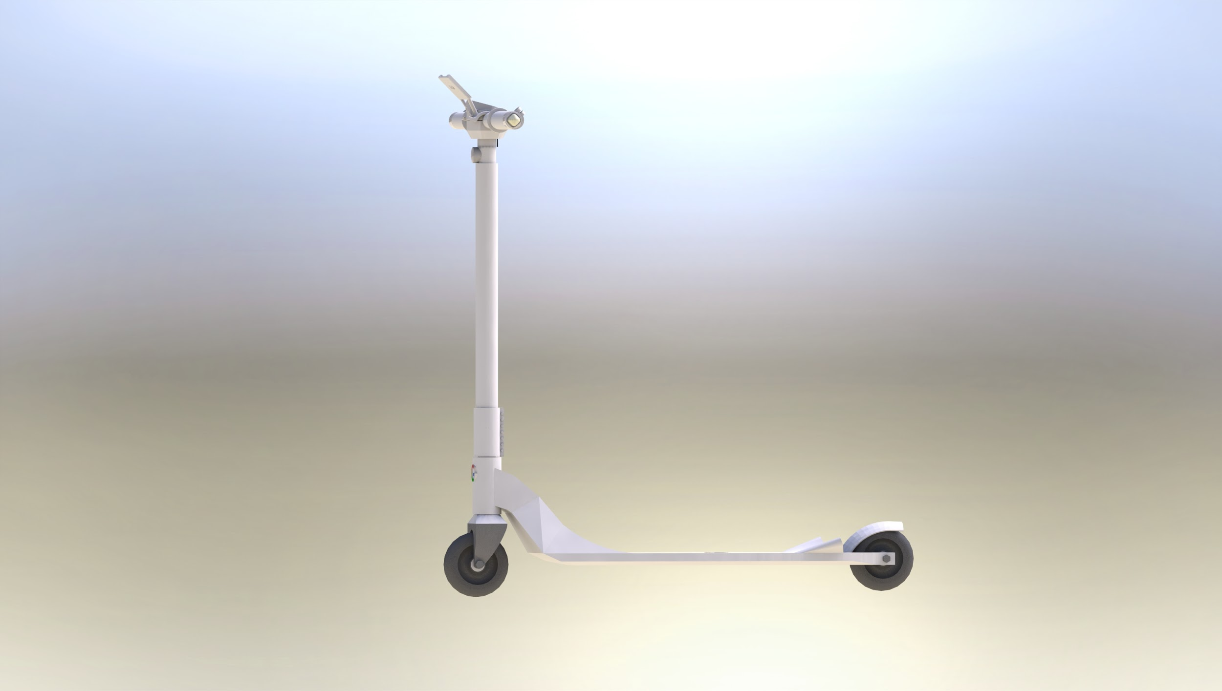
Design
LCD screen holder
LED turn signals
Product Design Language of Google
Intentions behind Scooter
Core experience
Journey to get to this point
~7 mins
Handles with integrated haptic engine
Headlight
Flared blind spot proximity sensor housings
Integrated deck with electronics panel and sensor suite with gyroscope and accelerometer

Slide 5
Speed Reduction
Headlight
Vibrating Disc
(Left)
Vibrating Disc
(Right)
Reduction Circuit
Headlight
Control
ATmega328p
GPS
Proximity Sensor
Gyroscope
Pressure Sensor
(Left)
Pressure Sensor
(Right)
PhotoSensor
High Level Block Diagram

Slide 6
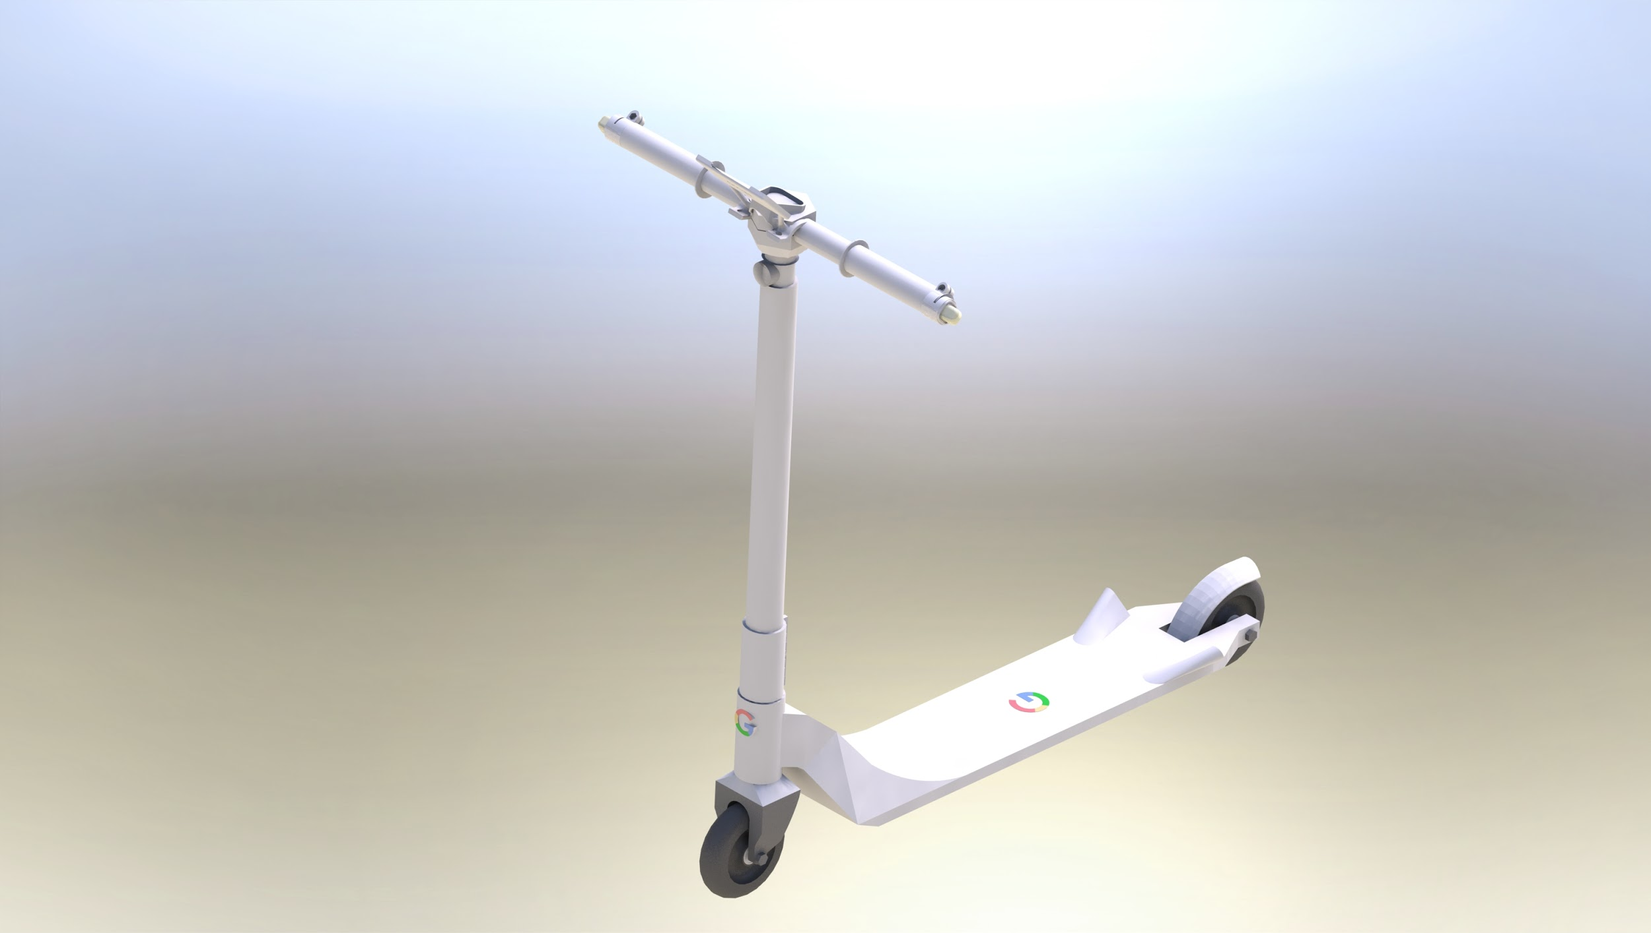

Automatic Headlight
Senses the brightness of the surrounding
Automatically turn on / off the headlight depending on the intensity of the light
Components:
Adafruit ALS-PT19 Analog Light Sensor
SN74LS125AN Tri-State Buffer
Input - Analog voltage from light sensor based on brightness
Output - Active low tri-state enable signal to simulate button press

Slide 7
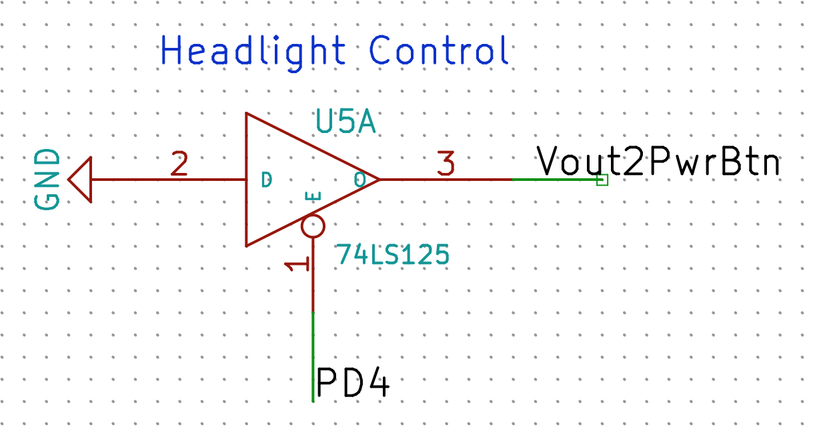
Automatic Headlight
Notes:
Hardware
Click of power button on the scooter toggles state of headlight
Simulate the button press from the software
Software
Convert input analog voltage from the sensor using ADC
Activate tri-state buffer to send a button trigger only at every state transition to toggle on / off

Slide 8
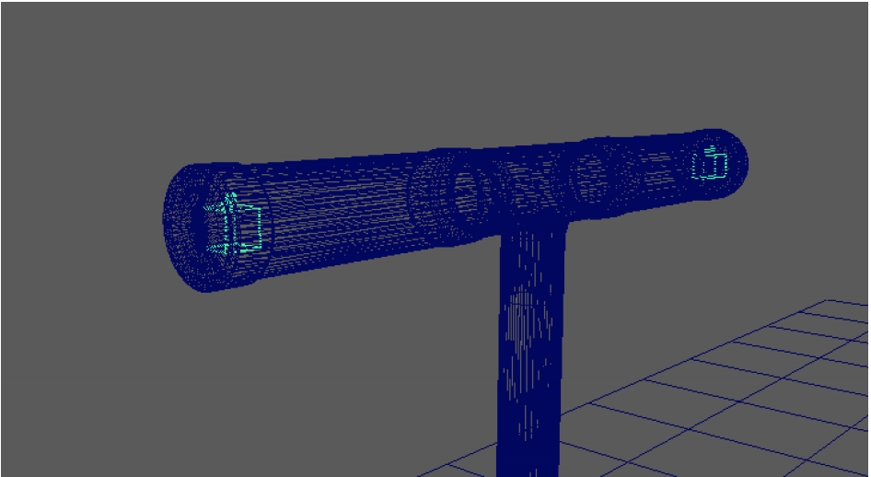
Smart Speed Regulator - Handle Bar
Detects rider’s hand placement on the handles
Automatically slows down to a halt if any of the hands are off
Components:
2 x Adafruit Force Sensitive Resistor
Voltage Divider + Tri-State Buffer
Input - Two different analog voltage values from each of the pressure sensors
Output - Digital signal to indicate whether both FSRs detect hand placement on the handlebars

Slide 9
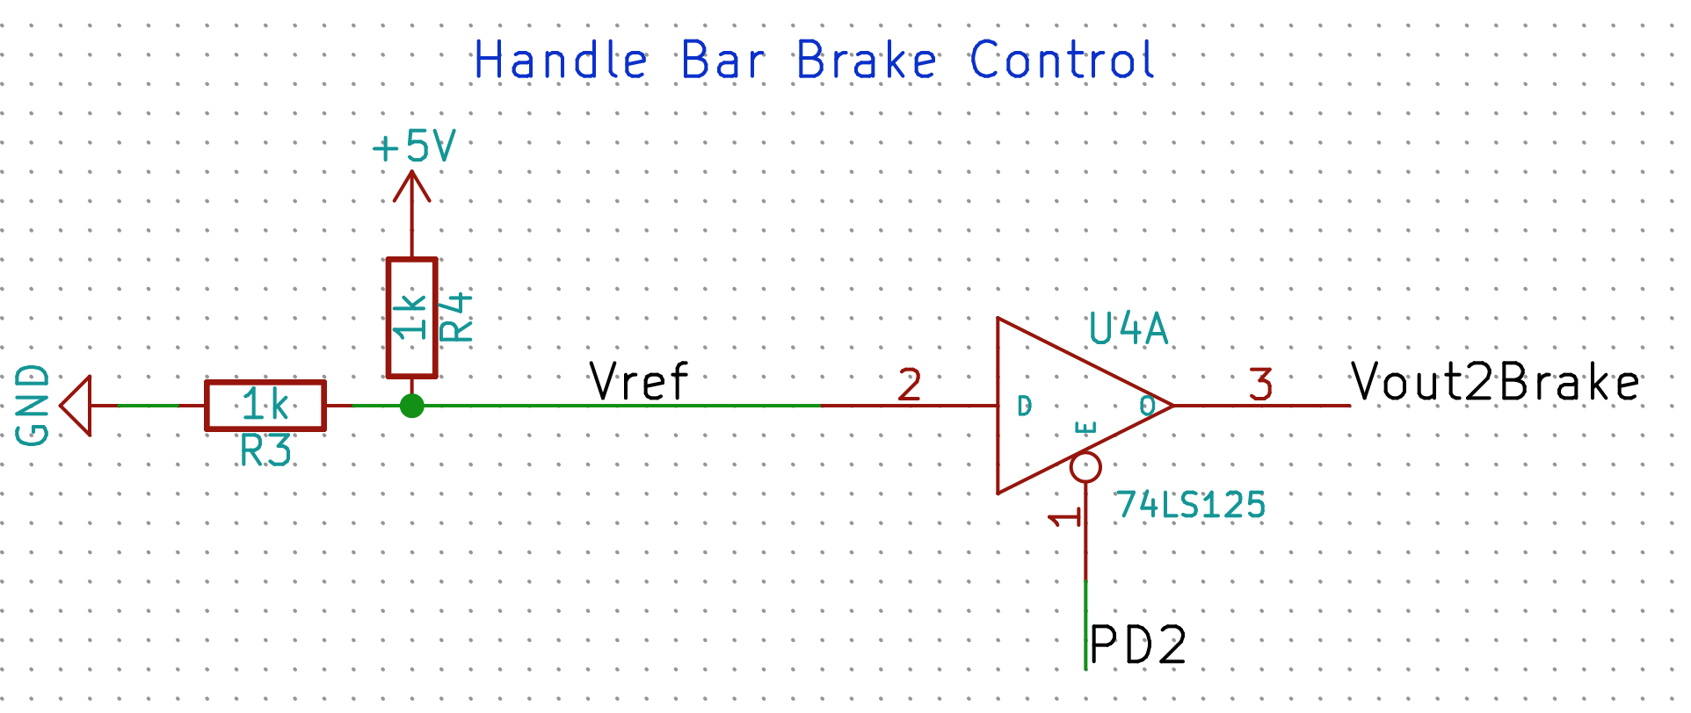
Smart Speed Regulator - Handle Bar
Notes:
Hardware
Brake sends varying levels of analog voltage depending on the push
The harder rider pushes, more load the brake gives
Emulate a “soft” push on the brake to slowly halt if hands are off
Convert 5V digital signal to ~2.5V
Software
Convert input analog voltages using ADC
If either hand not detected (less than threshold voltage), trigger a signal

Slide 10

Smart Speed Regulator - Downhill
Detects scooter going downhill
Limiting the acceleration to prevent scooters from descending too fast
Components:
Adafruit LIS3DH Triple-Axis Accelerometer
Voltage Divider
Op-amp + MOSFET
Input - gravity acceleration values in x, y, z axes from the accelerometer
Output - Digital signal indicating whether the scooter is going downhill

Slide 11
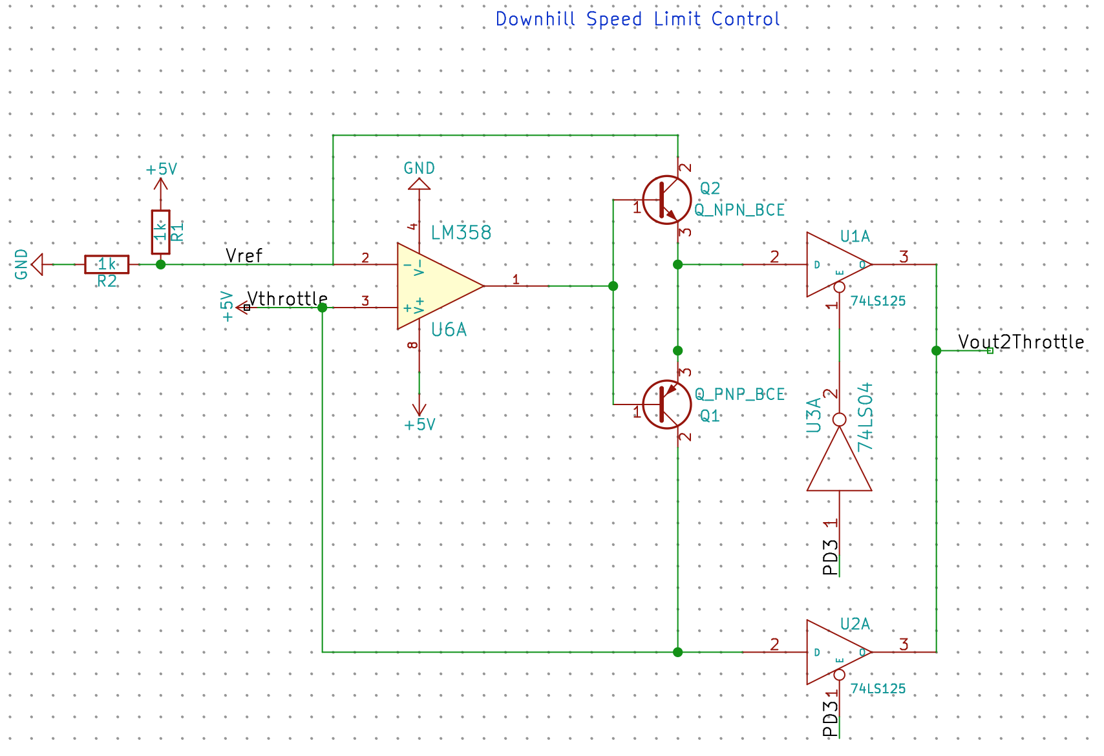
Smart Speed Regulator - Downhill
Notes:
Hardware
Throttle sends varying levels of analog voltage depending on the push
Limit the throttle push at a certain voltage
Cap the output voltage around ~2.75V
Software
Obtain gravity readings for all 3 axes using I2C
Send a digital signal indicating downhill detection
Use state machine and counter to stabilize acceleration readings

Slide 12
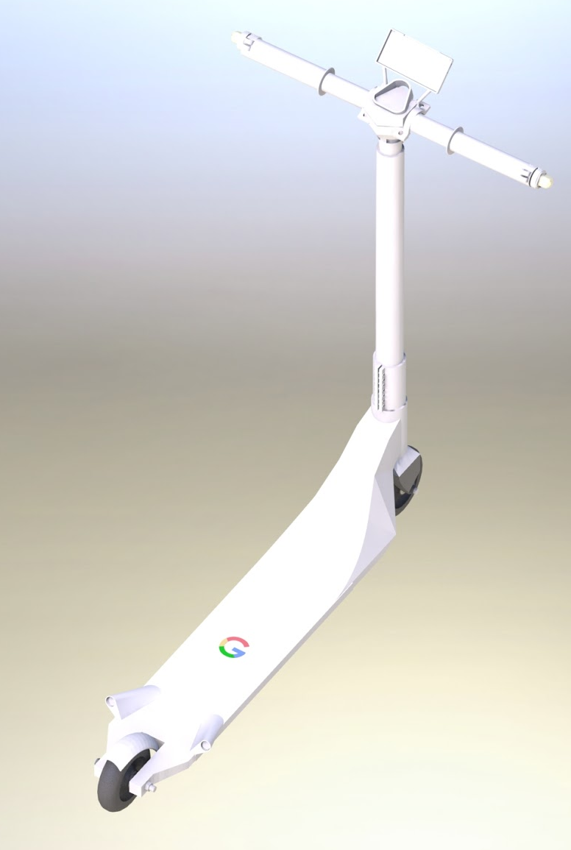


Vehicle Proximity Alert
Detects nearby vehicles on the road
Alerts the rider which side a vehicle is detected
Components:
2 x Adafruit Vibrating Disk
2 x HC-SR04 Ultrasonic Distance Sensor
Input - Distance to the closest detectable object from the two ultrasonic sensors
Output - Activate the corresponding vibrating disk when either sensors detect a close enough object
Notes:
Software
Send capture trigger to ultrasonic sensors every 60ms cycle
Alternate between left and right
Store the corresponding left / right values on every receive or timer interrupt
Simply retrieve the stored distance values in the main loop
Instead of being blocked on the entire capture process
Turn on the corresponding vibrating disk when object detected

Slide 13
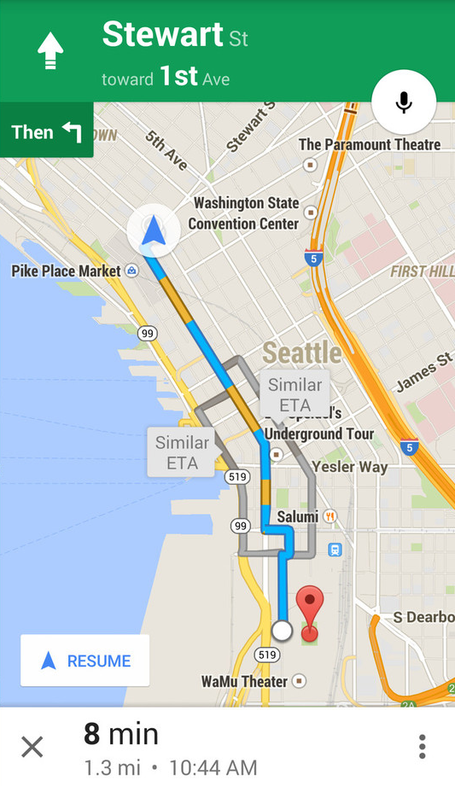
GPS Data
Receive GPS data
Update LCD map and send data to server
Components:
Adafruit GPS Module
Input / Output - GPS location data
Software
Receive GPS data using Interrupt-enabled Serial receiver
Corrupts range data
Ideally move to a dedicated processor

Slide 14
Conclusion
While the market may have many options, we believe that Google is the one brand that has the potential to enter successfully.
Google Go. A new mobility experience
from Google.
Notes:
Google ride
Scoogle
Google Go

